Slide 1
Radioactive Waste Management
More than Spent Nuclear Fuel

Slide 2
Definition Of
Radioactive Waste
any material no longer useful that contains radioactive isotopes in amounts recognized by regulatory authorities as posing a potential risk to human health and the environment
sufficient to warrant its isolation from the biosphere
characterized by emission of alpha, beta, gamma, or neutron energy

Slide 3
Scope of Radwaste Management (RWM)
nuclear fuel cycle (front end-back end)
commercial power plant operation
long term storage (Yucca Mountain)
industrial technologies/consumer products
weapons stewardship
medical physics/nuclear medicine/radiopharmaceuticals
defense waste/naval propulsion
non-proliferation

Slide 4
Scope of Radwaste Management (RWM)
site clean-up
phosphate production
chemistry, chemical separations, and chemical engineering
geology (structural and ground water flow)
civil engineering
meteorology (air dispersion)
materials engineering
regulatory laws
  NIMBY- Not In My Back Yard
  NIMTOO- Not In My Term Of Office

Slide 5
Nature And Magnitude of The Problem
compared to other societal waste - radwaste is relatively limited in scope and occupies far less space
radwaste material may be in large volumes with relatively low concentrations of isotopes or may in be small volumes with high concentrations of isotopes even providing lethal exposures

Slide 6
Nature And Magnitude of The Problem
storage may be from several days (interim: hospitals) to hundreds (LLW) to thousands of years (HLW)
total low-level waste volume at commercial facilities > 2 million ft³
at 30 lb/ft³ this is about 30,000 tons compared to New York having 15 million tons/yr of municipal solid waste (MSW)

Slide 7
Nature And Magnitude of the Problem
in comparison radwaste may be considered to be managed as a hazardous waste more than MSW
Hazardous wastes were regulated by the resource conservation and recovery act (RCRA) was about 150 million metric tons
fundamental difference between radwaste, and MSW and hazardous waste management is that the engineering barriers are assumed to eventually fail

Slide 8
High Level Waste (HLW)
CURRENTLY EXISTS AT:
  Hanford; Washington State
  Savannah River; South Carolina
  Idaho National Engineering (INL)

Slide 9
HLW Storage
DOE has estimated that some 13 million ft³ of HLW exists:
  in various physical forms (liquid, sludge, salt cake, and dry calcine)
  in various containers (single and double shell tanks, and various bins)
  with an approximate activity of 1.8 × 10⁹ Curies

Slide 10
Spent Nuclear Fuel
since the 1970’s there has been no commercial fuel reprocessing
spent fuel is now stored in the pools of commercial power plants with eventual disposal planned in a high level repository site such as Yucca Mountain
currently, there are considerations to produce Mixed Oxide (MOX) fuel from plutonium from disassembled nuclear weapons

Slide 11
National Character of RWM
tremendous benefits to citizens from the waste generated from nuclear materials
long term solutions are needed to store the long-lived isotopes
proper management is essential for public safety and environmental stewardship

Slide 12
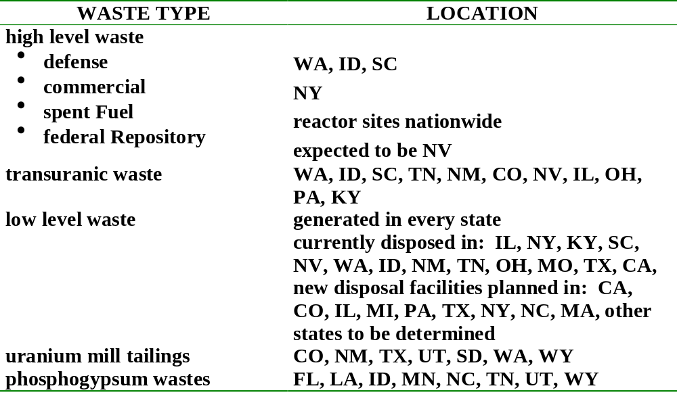
Location of Existing & Projected Radioactive Waste

Slide 13
Legacy of Past Disposal of Radioactive Waste
cold war politics made it imperative to have ten’s of thousands of nuclear weapons
designed, manufactured and tested at different government facilities
resulted in long term storage of radioactive wastes in underground tanks for liquids and sludges
currently there is a recognition of leakage from these tanks

Slide 14
Legacy of Past Disposal of Radioactive
poor management of uranium mill tailings:
  windblown materials
  surface water contamination
  radon evolution from these tailings
  effect on miners

Slide 15
Future Areas of Study/Management
changing regulatory requirements for transuranics
need for remedial actions
better understanding of transport and exposure pathways of radioactivity in the biosphere
socioeconomic considerations are also needed for RWM practices

Slide 16
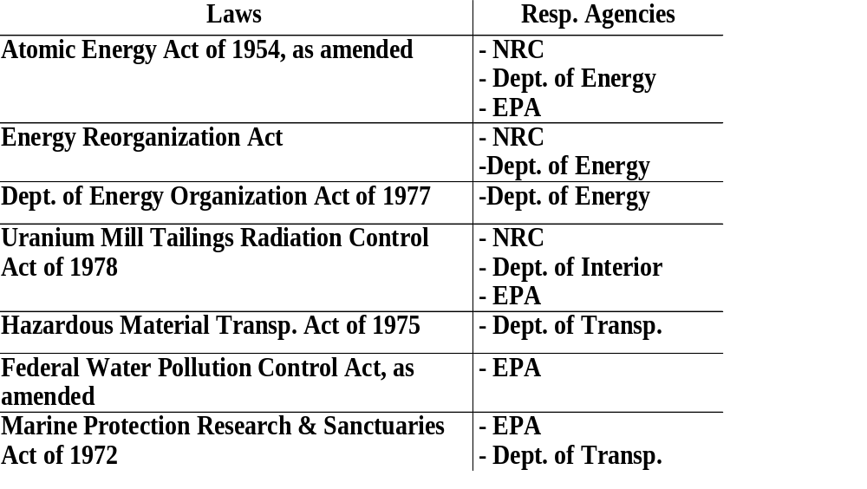
Federal Laws & Agencies With Responsibility
For Us Radioactive Waste Management
Program

Slide 17
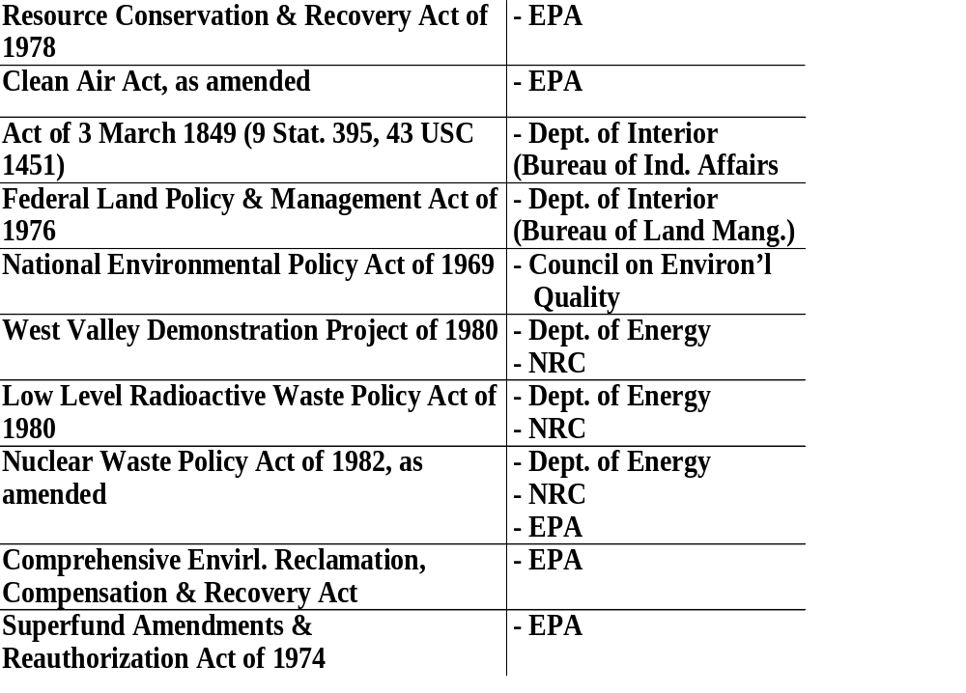

Slide 18
Current Status Of RWM in the USA
  Yucca Mountain- shut down
  interim storage facility
  Waste Isolation Pilot Plant (WIPP)
  low-level RWM- compact with states
  decommissioning of existing reactors
  economic and technical help to the former Soviet Union
  continued management of mining and milling of uranium

Slide 19
RWM Implications of Accidents
Wyndscale, England (1957)
Rocky Flats Fire, USA (1957)
Chalk River, Canada (1958)
Khyshtym, Russian Urals (1958)
Rocky Flats Fire, USA (1969)
Three Mile Island, USA (1979)
Chernobyl, Russia (1986)
Goiania, Brazil (1987)
Fukushima, Japan (2011)

Slide 20
RADWASTE FORMS
Overview

Slide 21
Uranium Mining And
Mill Tailings
the element U was discovered in 1789 by Klaporthe and named after the new planet Uranus
it is distributed over the entire earth’s crust at an average crustal abundance of
2 ppm (μg/g)
U is more abundant than gold or silver

Slide 22
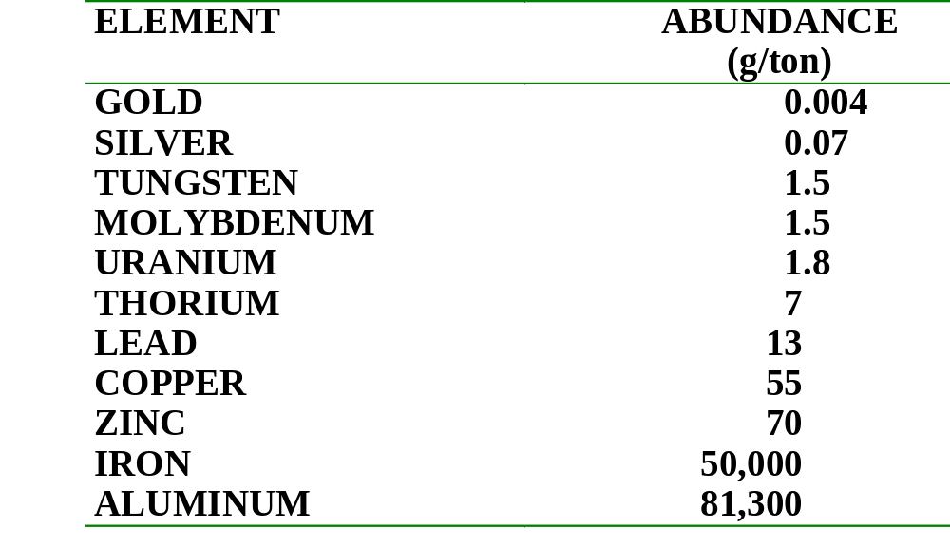
Crustal Abundance of
Selected Elements

Slide 23
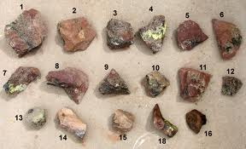
Uranium Minerals
there are about 100 U bearing ores having different concentrations:
uranite: UO₂
davidite: (Fe, Ce, LA, Y, U, Ca, Zr, Th) (Ti, Fe, Cr,V)₃ (O,OH)
brannerite: (U, Ca, Fe, Th, Y)₃ Ti₅O₁₆
carnotite: K(UO₂)₂ (VO₄)₂.3H₂O
tyuyaminite: Ca(UO₂)₂ (Vo₄)2.5 - 8 H₂0
atunite: Ca(UO₂)₂ (Po₄)₂.10 - 12 H₂0
uranophane: Ca(UO₂)₂ SiO₃(OH)₂.5H₂0

Slide 24
Uranium ExplorationTechniques
geological studies
airborne surveys for gamma detection
surface surveys for x-ray analysis
hydrochemical surveys of water:
  radon concentrations > 10³ pCi/L or
  radium concentrations > 5 pCi/L
well logging
botanical methods (U - Se)
U from seawater (possibly economical)

Slide 25
Mining Options (ore deposits between 0.03 – 0.5 %)
Open Pit Mining
Underground Mining
  concern of inhalation of radon gas
  NRC (1979) estimated release of 20 Million Ci of radon from 1978 – 2000 from mining and milling
In Situ Leaching
  eliminates stripping, mining, and milling
  U recovery from lower grades

Slide 26
Milling of Uranium Ore
Management of Mill Tailings as RW:
waste management is required since about 6% of the original U content is not recovered
DOE estimated 5 billion ft³ of tailings will exist by the year 2000 and some 600 million ft³ need remedial action

Slide 27
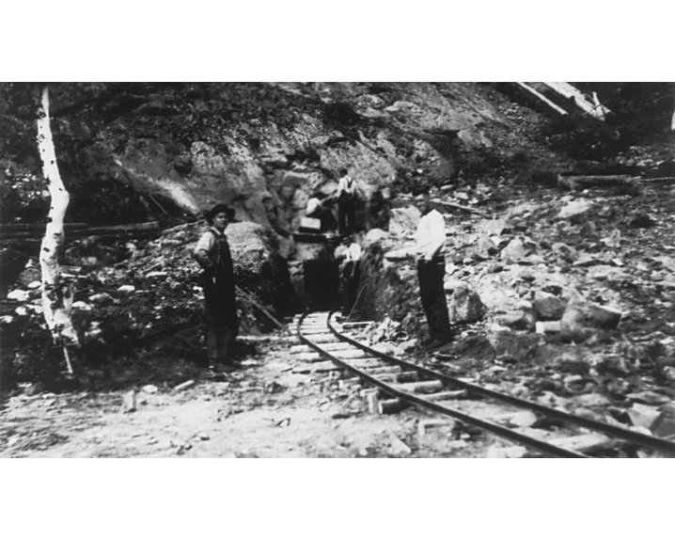
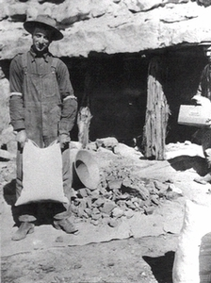
Canadian Uranium Mining
Canadian Mine
Utah Mine

Slide 28
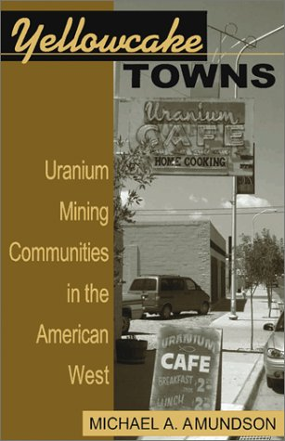

Slide 29
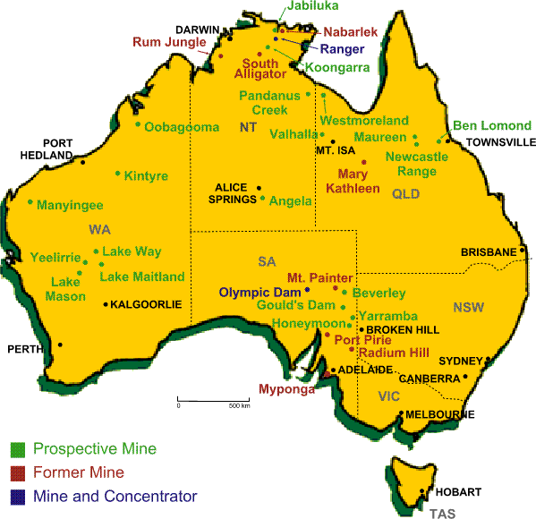

Slide 30
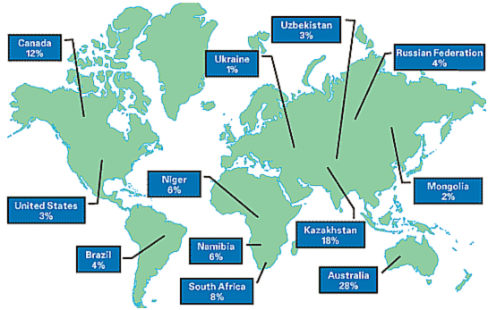
World Wide Uranium Mines

Slide 31
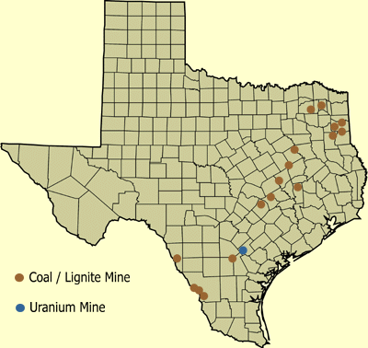
www.txpeer.org/toxictour/ uri.html

Slide 32
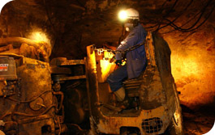
Underground Uranium Mine in Niger

Slide 33
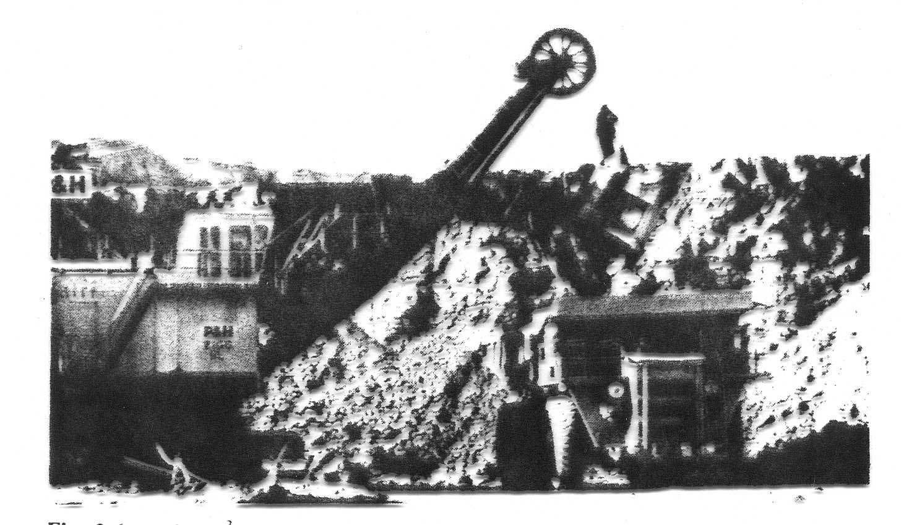
35-yd³ ore-hauling truck coming out of an ore pit

Slide 34
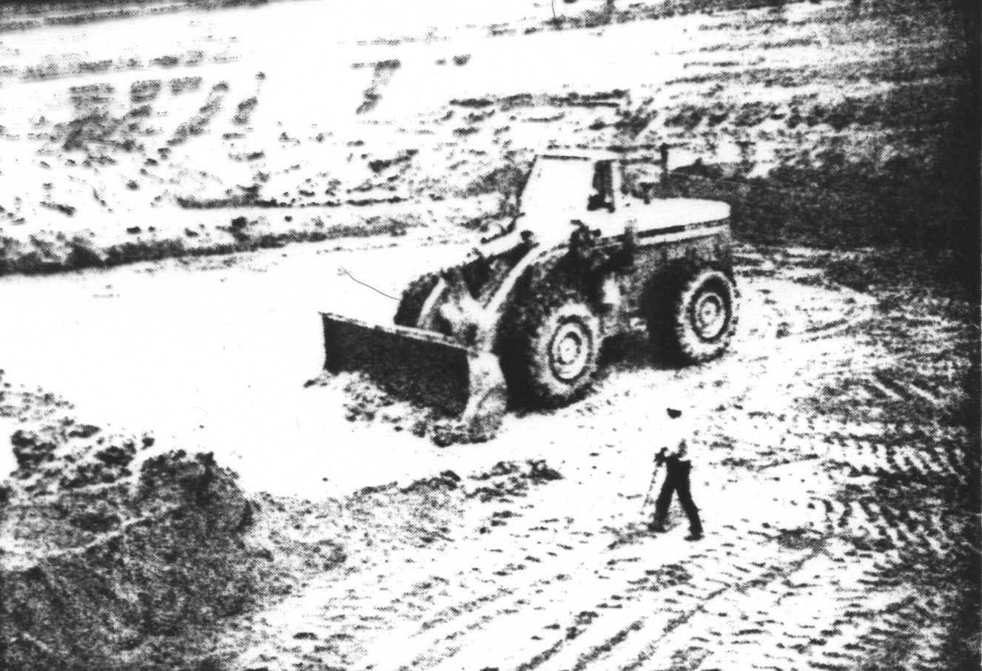
Front-end hauler picking up uranium ore as directed by a radiological technician – technician is using a G-M counter to locate uranium ore

Slide 35
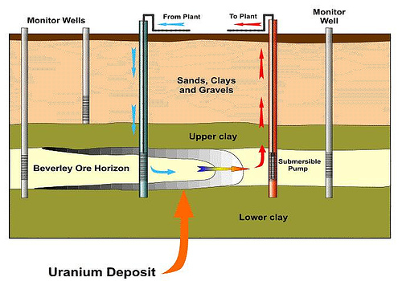
In situ leach

Slide 36
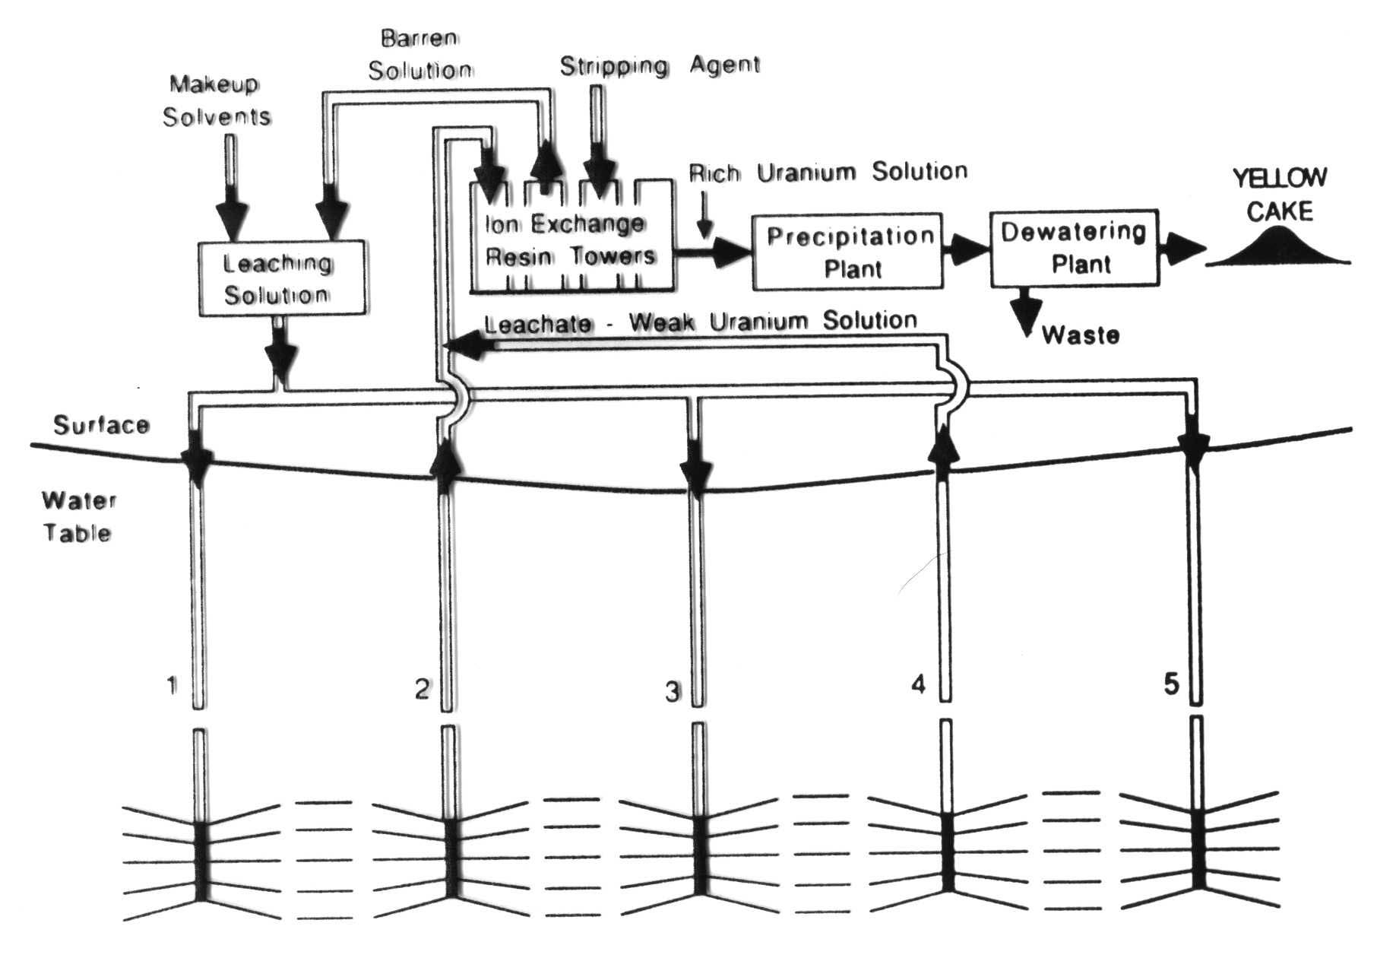
Diagram of in situ leaching

Slide 37
Milling of Uranium Ore
waste material is released to a tailing pond and receives almost all the Ra and other decay products
1978 Congress passed the Uranium Mill Tailings Control Act.
1982 - 1983 US EPA proposed standards for clean-up and disposal

Slide 38
ore pad
crusher
fine ore storage
roasting & quenching (removes organics)
grinding
leaching
counter current decontamination
to tailings waste pond
decay products metals/radon
pregnant leach liquor
solvent extraction
pregnant organics
U stripping
pregnant U strip solution
U-precipitation & washing
centrifuge & drying
packaging & storage of U₃O₈
Uranium Processing Flow Chart
NH₄ Cl (strip sol.)
H₂SO₄
NaClO₃
flocculent
filter
Water for dilution
NH₃

Slide 39
RADWASTE IS GENERALLY CLASSIFIED BY:
source of waste
radiological concern
actual radioactive materials
procedures that produce radioactive waste (RW)

Slide 40
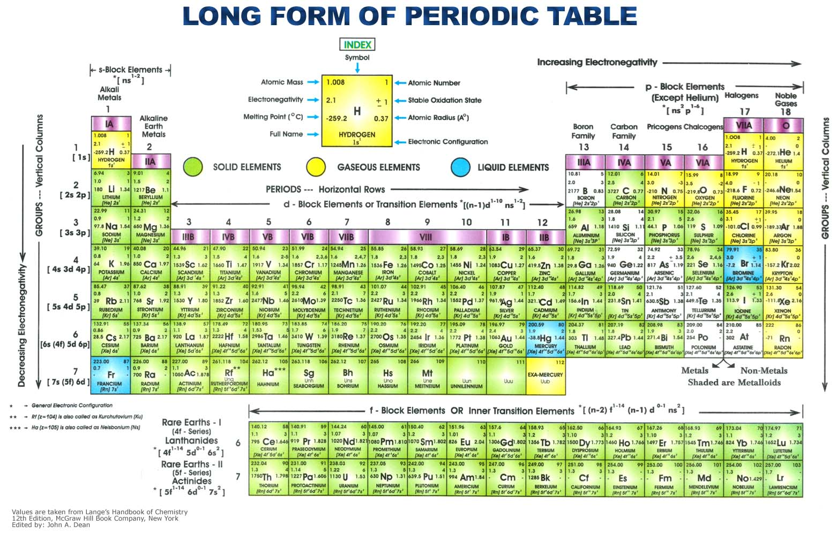

Slide 41

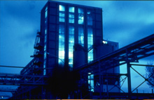
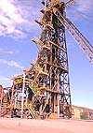
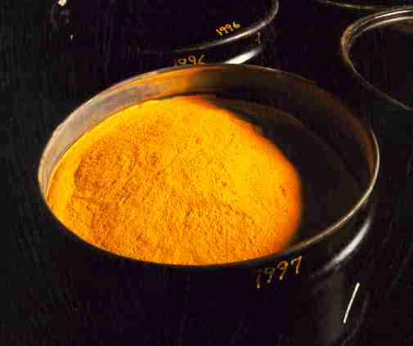
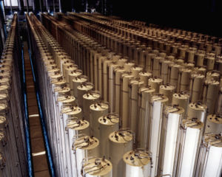

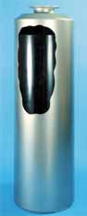
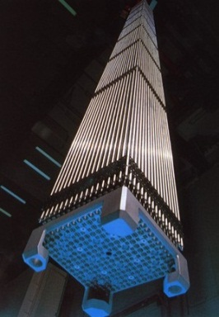
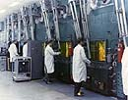
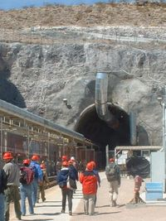
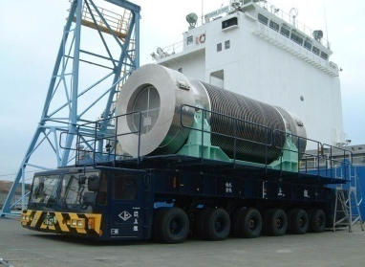

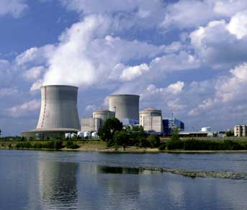
The Nuclear Fuel Cycle
Uranium Mining,
Milling, Refining
Conversion
Enrichment
UF₆
(gas)
Depleted
Uranium
Yellowcake
(U₃O₈)
Ore Tailings
Enriched
UO₂
Vitrification
Pu and
(maybe)
other
actinides
High
Level
Waste
(HLW)
Fuel
Fabrication
Vitrified
HLW
Reprocessing
Fuel
Assemblies
Irradiated
Fuel
e⁻
Disposal
Onsite Cooling
Storage
Transportation
Reactor

Slide 42
Nuclear Fuel Cycle Wastes
uranium mine and mill tailings
waste from conversion, enrichment, and fuel fabrication
nuclear power production
spent nuclear fuel

Slide 43
Nuclear Fuel Cycle – Front End
mining – getting the ore out of the ground
milling – grinding, crushing, extraction from ore
conversion – converting to suitable chemical form for later processing
enrichment – Increase amount of ²³⁵U for criticality
fuel fabrication – UO₂ powder pressed into pellets, sintered, and loaded into seamless zircalloy tubes to form the fuel rods. Rods are bundled to form fuel assemblies.
reactor operations – producing electricity

Slide 44
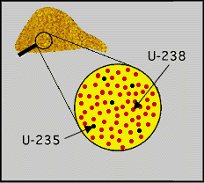
Uranium Mining
two natural isotopes of uranium – ²³⁵U (0.72%) and ²³⁸U (99.27%)
all mining creates waste.
waste from U mining includes waste rock.
danger comes from release of Rn gas and water seepage containing radioactive and toxic materials.

Slide 45
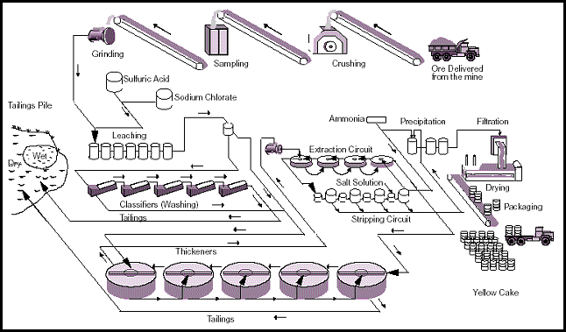
Uranium Milling

Slide 46
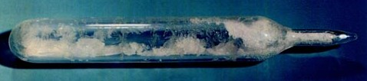
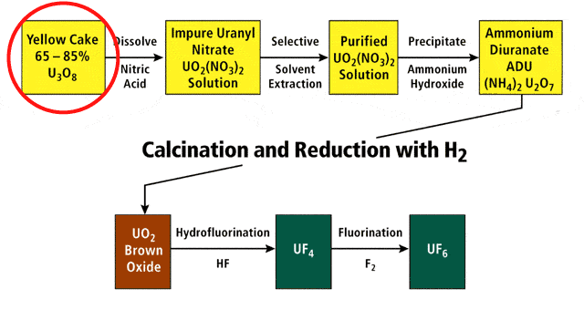
Fuel Conversion
Yellowcake must be converted to a chemical form that can be enriched – UF₆

Slide 47
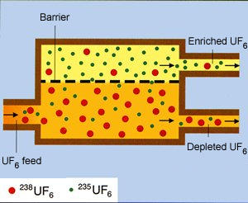

Fuel Enrichment
Gaseous diffusion is method generally used in the enrichment process.
This process is repeated many times to reach desired enrichment of 3%-5% in ²³⁵U. ²³⁸UF₆ now considered “depleted U”.

Slide 48
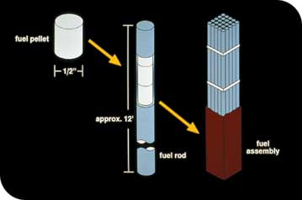
Fuel Fabrication
Last stage of front end of NFC before fuel is ready for use in reactor.
Fabrication begins when the UO₂ powder is pressed into pellets and baked at temps of ~ 1700C to create hard, ceramic pellets.
In an LWR, the fuel pellets are packed into thin zircalloy tubes called fuel rods. The fuel rods grouped together into a bundle called a fuel assembly.

Slide 49
Reactor Operations
fuel assemblies are put in reactor core along with a moderator, such as water or graphite.
²³⁵U undergoes fission and releases energy in the process. This energy heats the water and turns it into steam. The steam drives a turbine connected to a generator which produces electricity.
fission in a nuclear plant is a source of heat the same way that coal, gas or oil burning is used as a source of heat in a thermal power plant.
most commercial reactors are either:
  BWR – Boiling water reactor
  PWR – Pressurized water reactor

Slide 50
Nuclear Fuel Cycle – Back End
removal from reactor
temporary storage
reprocessing
recycling
permanent waste disposal

Slide 51
Removal from Reactor
after use and removal from the reactor, the fuel is then termed “spent fuel”.
the original amount of uranium has decreased due to fission (though a lot of useable uranium is left!!)
fission products have accumulated and are the source of majority of radioactivity.
reactor components have also become radioactive due to neutron activation.

Slide 52
Temporary Storage
Two types of temporary storage
  Wet storage –
    spent fuel rods are placed in concrete pools of water on site.
    Water provides cooling and shielding against the hot fission products.
    Corrosion is a concern.
    Expensive.
  Dry storage –
    after cooling and decay of shorter-lived isotopes, the spent fuel rods can be removed from water, dried off, and placed in shielded storage.
    provide similar shielding as wet storage; corrosion not a concern.
    air circulation provides cooling.
    inexpensive.

Slide 53
Reprocessing/Recycling
Separates spent fuel into three components:
  fission products - waste
  ²³⁹Pu – can be mixed with ^{nat}UO₂ to create mixed oxide fuel (Europe)
  ²³⁵U – can be used again as reactor fuel
Reprocessing is much more expensive than storing
  most countries use dry storage for spent fuel (U.S., Canada)
  some reprocess for environmental/policy reasons (Russia, some European countries)
  some reprocess to gain/maintain energy independence (Japan)

Slide 54
Permanent Waste Disposal
no country has a permanent repository for disposal
Finland approved building of permanent repository in Southwest Finland (2001)
U.S. studying Yucca Mountain. received site approval in 2002 – undergoing licensing process-
  controversial
  political
  stopped in 2010

Slide 55
Nuclear Fuel Cycle Facilities
There are 12 nuclear fuel cycle facilities in the United States
  3 uranium mines (NM, WY(2))
  1 uranium mill (UT)
  1 conversion facility (IL)
  1 enrichment facility (KY)
  6 fuel fabrication facilities (NC, SC, TN, VA(2), WA
  others under construction
  http://en.wikipedia.org/wiki/Uranium_mining_in_the_United_States

Slide 56
Industrial Firms
radionuclides are used for many purposes across numerous industries worldwide
beta gauges
sealed sources for radiography
radiation hardening

Slide 57
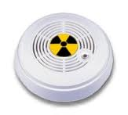

Radiopharmaceuticals and Medical Diagnosis, Research
radionuclides are used to treat many medical conditions
⁶⁰Co, ¹³⁷Cs, ³H, ³²P, ¹⁴C, ^{99m}Tc and various other isotopes
Consumer Products
  smoke detectors
  luminous watches

Slide 58
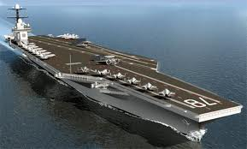
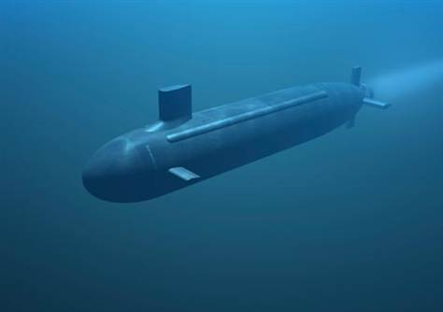
Defense Waste
plutonium and uranium extraction
tritium
nuclear submarines and aircraft carriers

Slide 59

Phosphogypsum Wastes
phosphate rock contains relatively high concentrations of U  up to 100-150 ppm
phosphate mines are primarily in TN, FL, ID, MT, UT, NC, and WY
when the ore is mined U-bearing material is brought to the surface and crushed
waste products include slimes and sands to those similar to U mine tailings

Slide 60
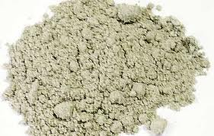
Phosphogypsum Wastes
to produce phosphate fertilizer, the ore is treated with sulphuric acid to produce phosphoric acid
  gypsum is a major by-product.
gypsum (CaS0₄) has ²²⁶Ra concentrations 30 - 40 pCi/g
gypsum piles in Florida are estimated to accumulate at the rate of 11 million metric tons/yr
various mitigating procedures are required

Slide 61
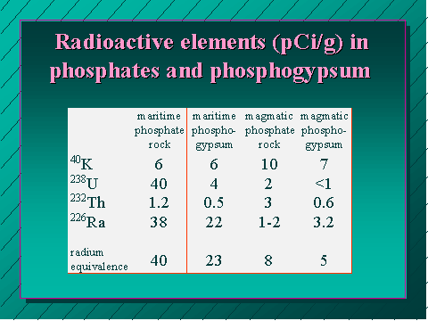

Slide 62
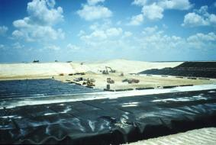
Phosphogypsum Pile

Slide 63
